Slide 1
Sales Analytics Project
Done By:
Dharshini A

Slide 2
Objectives
Build a professional Excel-based sales analytics dashboard
To analyze sales performance across categories, sub-categories, and regions.
To identify key revenue drivers, top-performing products, and customer segments.
To measure profitability and understand the impact of discounts on margins.
To evaluate operational efficiency through shipping mode analysis.
Automate reports with PivotTables, Charts, Slicers, and Macros

Slide 3
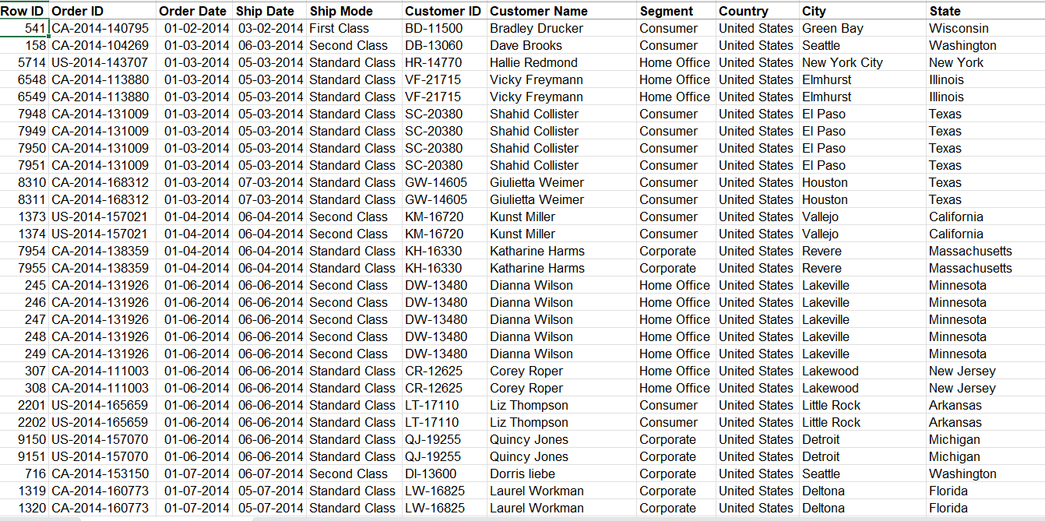
Data Preparation
Dataset: Superstore sales (Orders, Customers, Products, Shipping)
Cleaning Steps:
Removed duplicates & invalid dates
Created helper columns (Month-Year, Adjusted Sales, Profit Margin)
Standardized formats: Date, Currency, Percentages

Slide 4
Monthly Sales Trend
Line Chart: Sales vs. Time (Month-Year)

Slide 5
Sales Trend Chart
Chart: Category vs. Sales & Profit

Slide 6
Shipping Performance
Chart: Ship Mode vs. Avg Sales & Orders

Slide 7
Regional Analysis

Slide 8
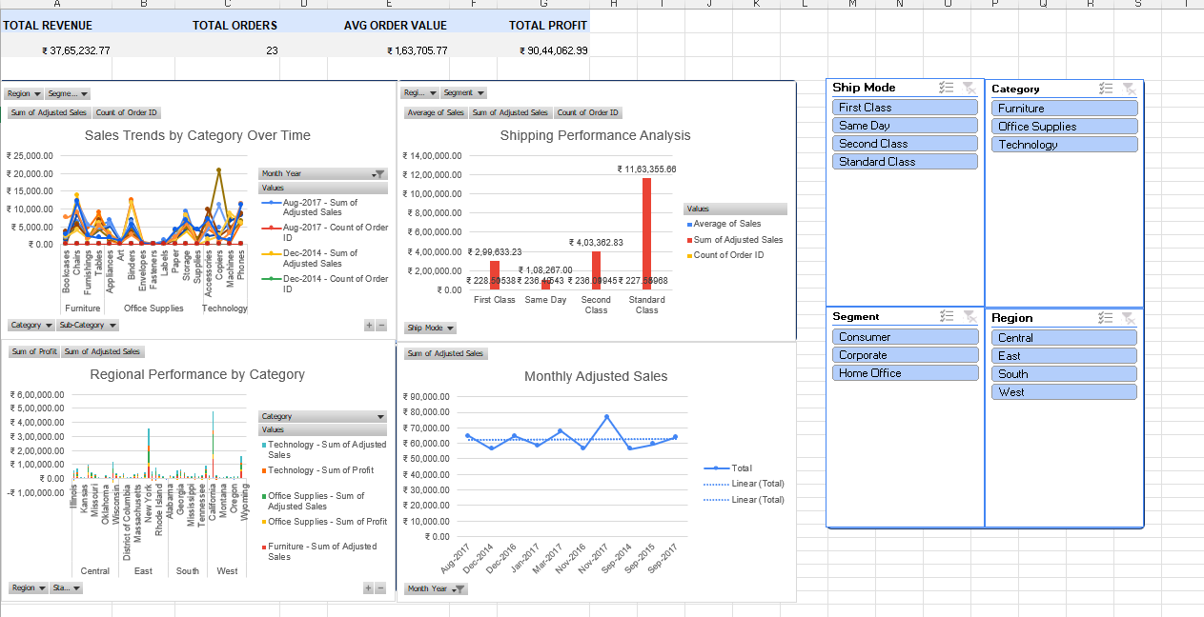
SUPERSTORE SALES ANALYTICS DASHBOARD

Slide 9
Automation
VBA Macros implemented:
FormatWorksheet: cleans & formats reports
RefreshAllData: updates all pivots & charts instantly
One-click automation saves analyst time

Slide 10
Conclusion
Excel Dashboard provides end-to-end analytics
Automated, interactive, and manager-ready reporting
Supports strategic decisions in Revenue, Customer, Operations, and Profitability

Slide 11
THANK YOU

